Slide 1


PREDICTING ABUNDANCE OF KEY ALGAL SPECIES
IN THE ROCKY INTERTIDAL OF
ACADIA NATIONAL PARK
NICK LAGONI
DSE 6311 – SU 2 2025
8 / 27 / 2025

Slide 2





Background
Macroalgae engineer their ecosystem
The rocky intertidal is changing
Ascophyllum nodosum and Fucus vesiculosus provide habitat, structure, and food for invertebrates in the rocky intertidal
This ecosystem is undergoing dramatic stress from climate change, invasives, and habitat loss

Slide 3
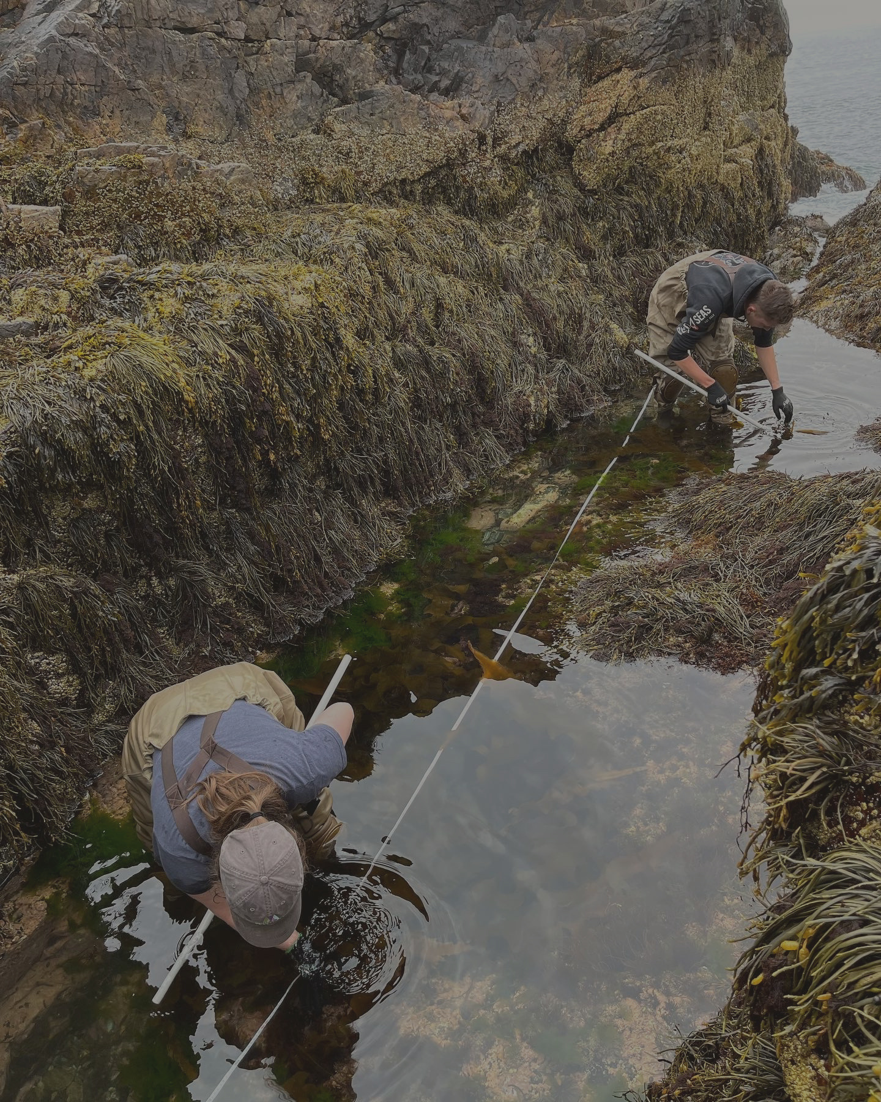
Research Question
Can we predict the abundance of important ecosystem engineers Fucus and Ascophyllum using ecological survey data from the previous year?

Slide 4
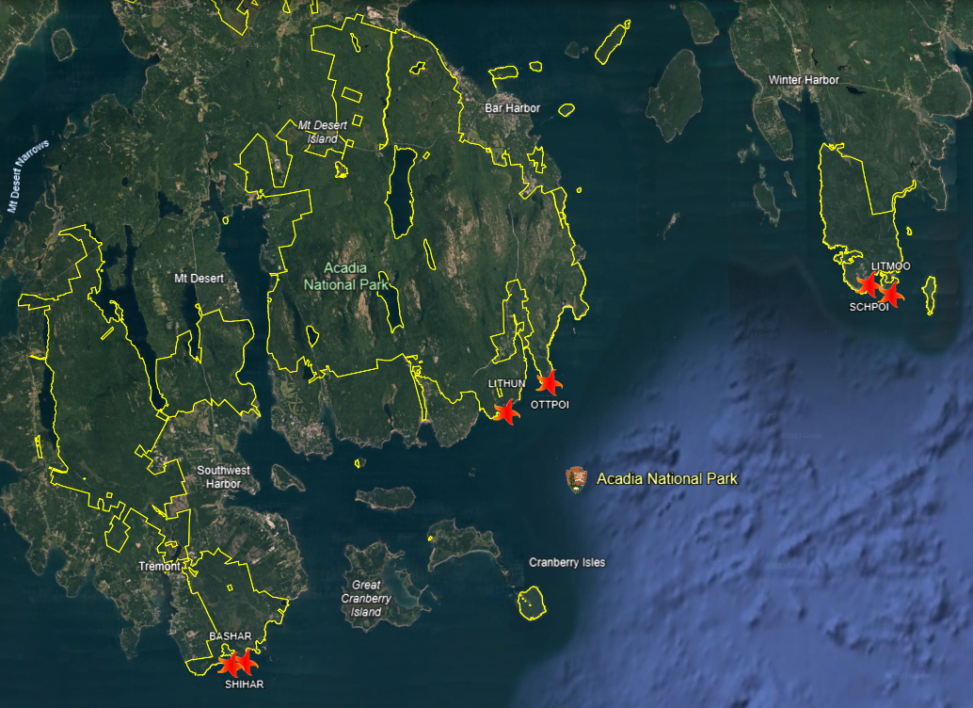
NETN Monitoring Protocol
Site Selection
Focus on broad temporal variation
Spatial variation not the focus
Fixed plots
Paired sites

Slide 5
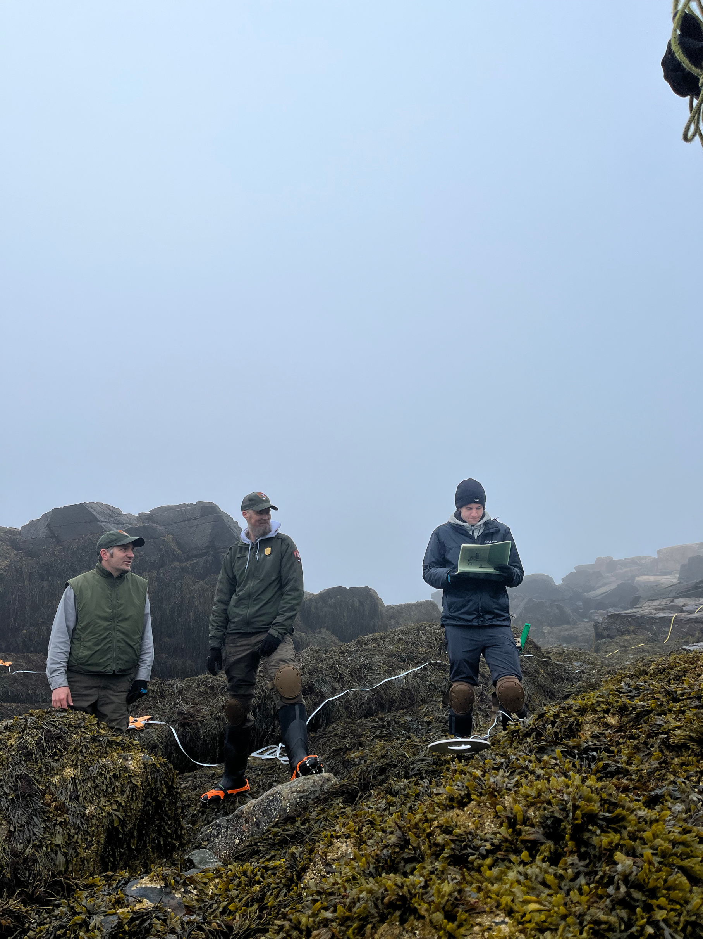
NETN Monitoring Protocol
Invertebrates & Algae
Long term count data
Five specific target communities

Slide 6
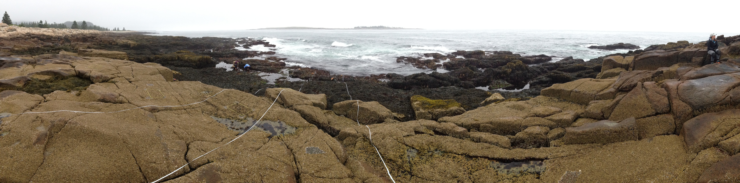
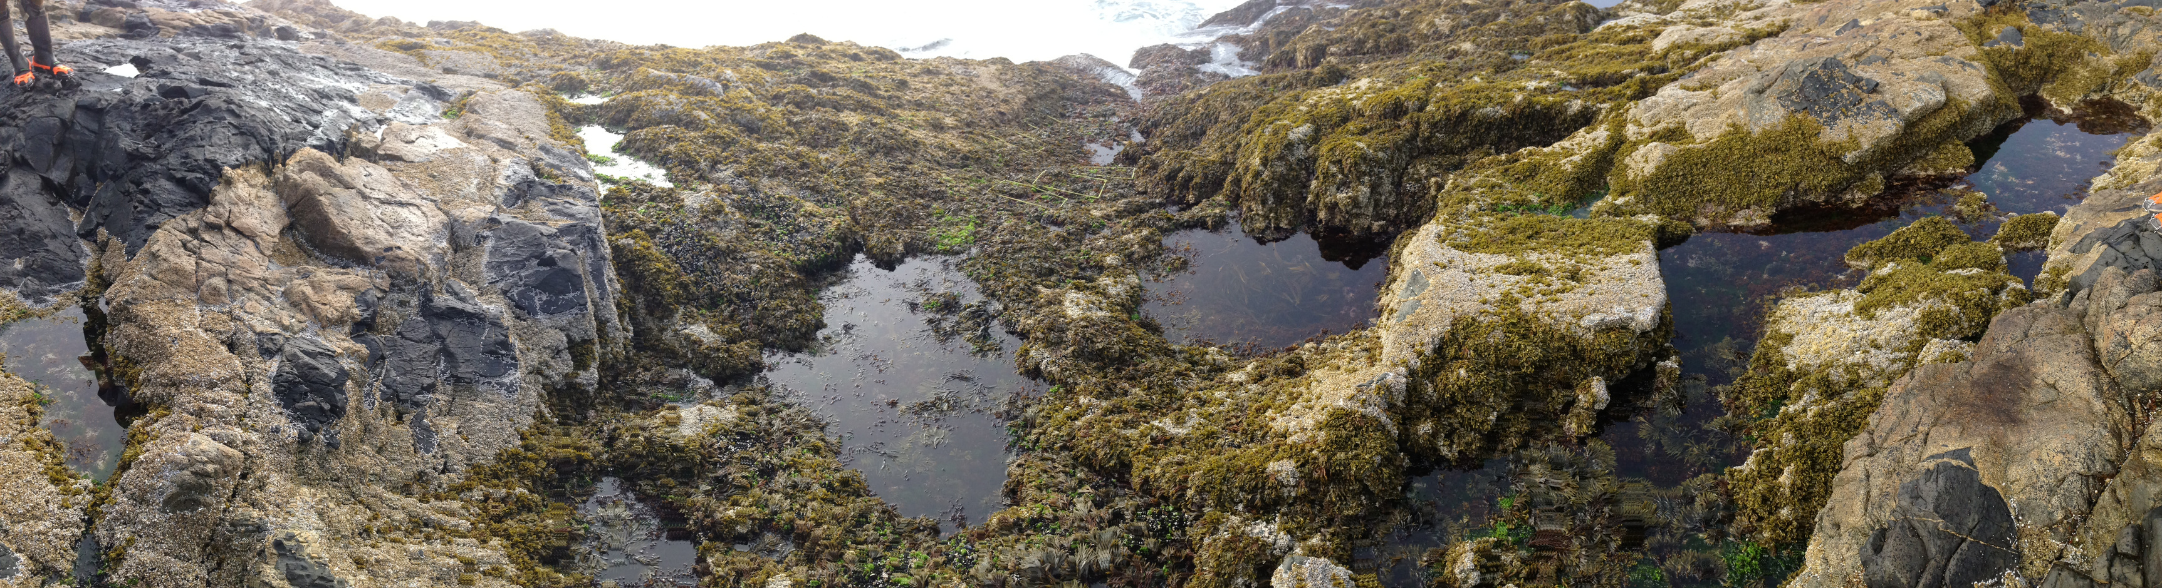
NETN Monitoring Protocol
Barnacles
Invertebrates & Algae
Long term count data
Five specific target communities
Barnacles
Mussels
Mussels

Slide 7
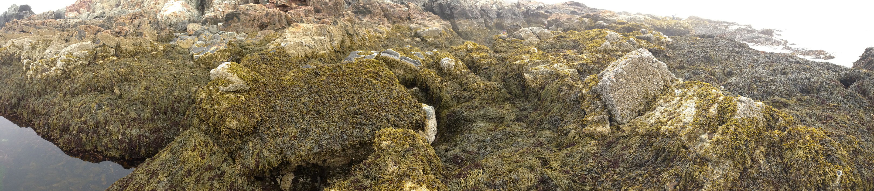
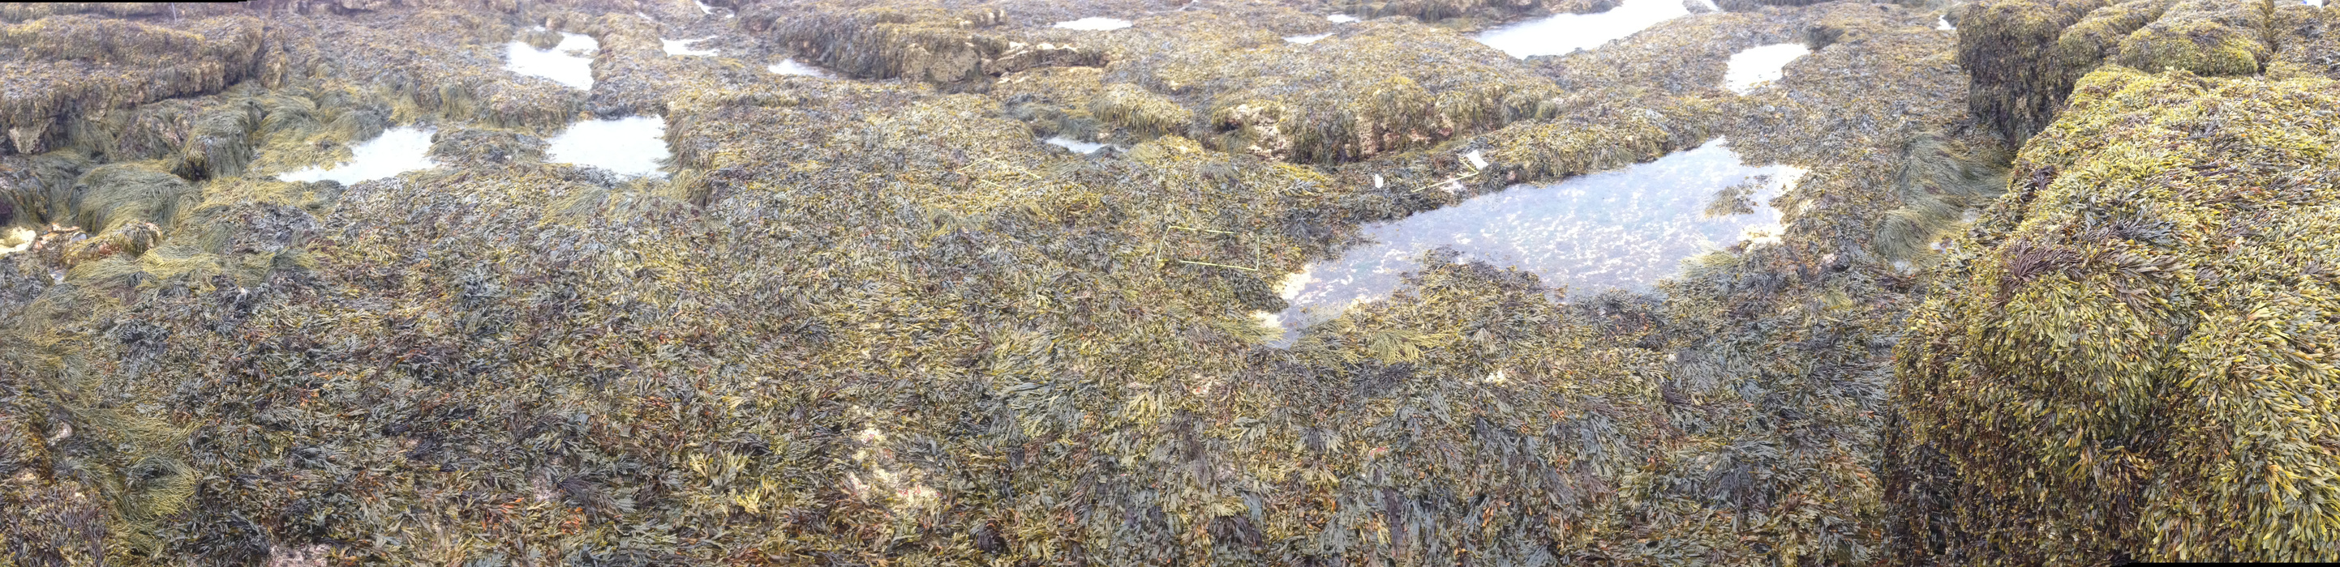
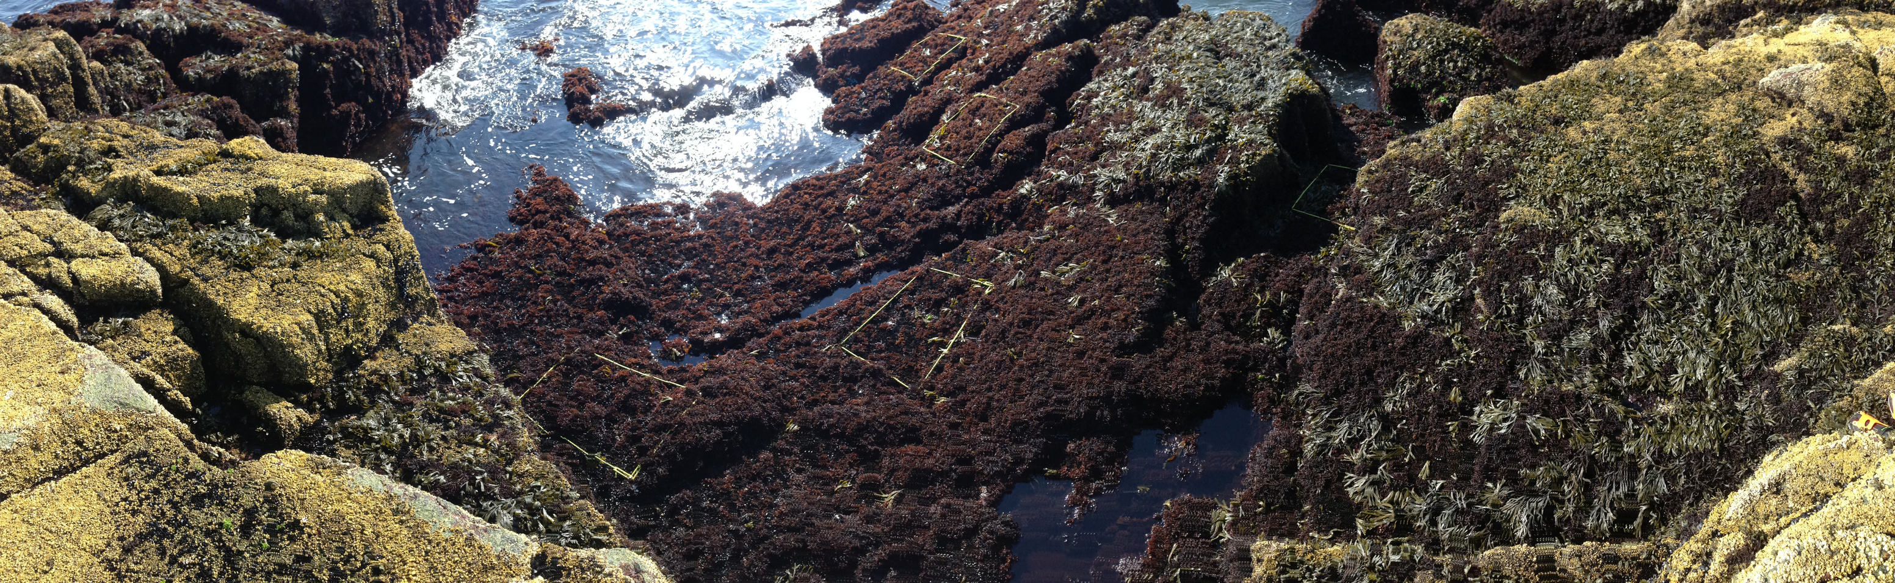
Ascophyllum
NETN Monitoring Protocol
Fucus
Invertebrates & Algae
Long term count data
Five specific target communities
Barnacles
Mussels
Ascophyllum nodosum
Fucus vesiculosis
Red algae spp.
Red Algae

Slide 8
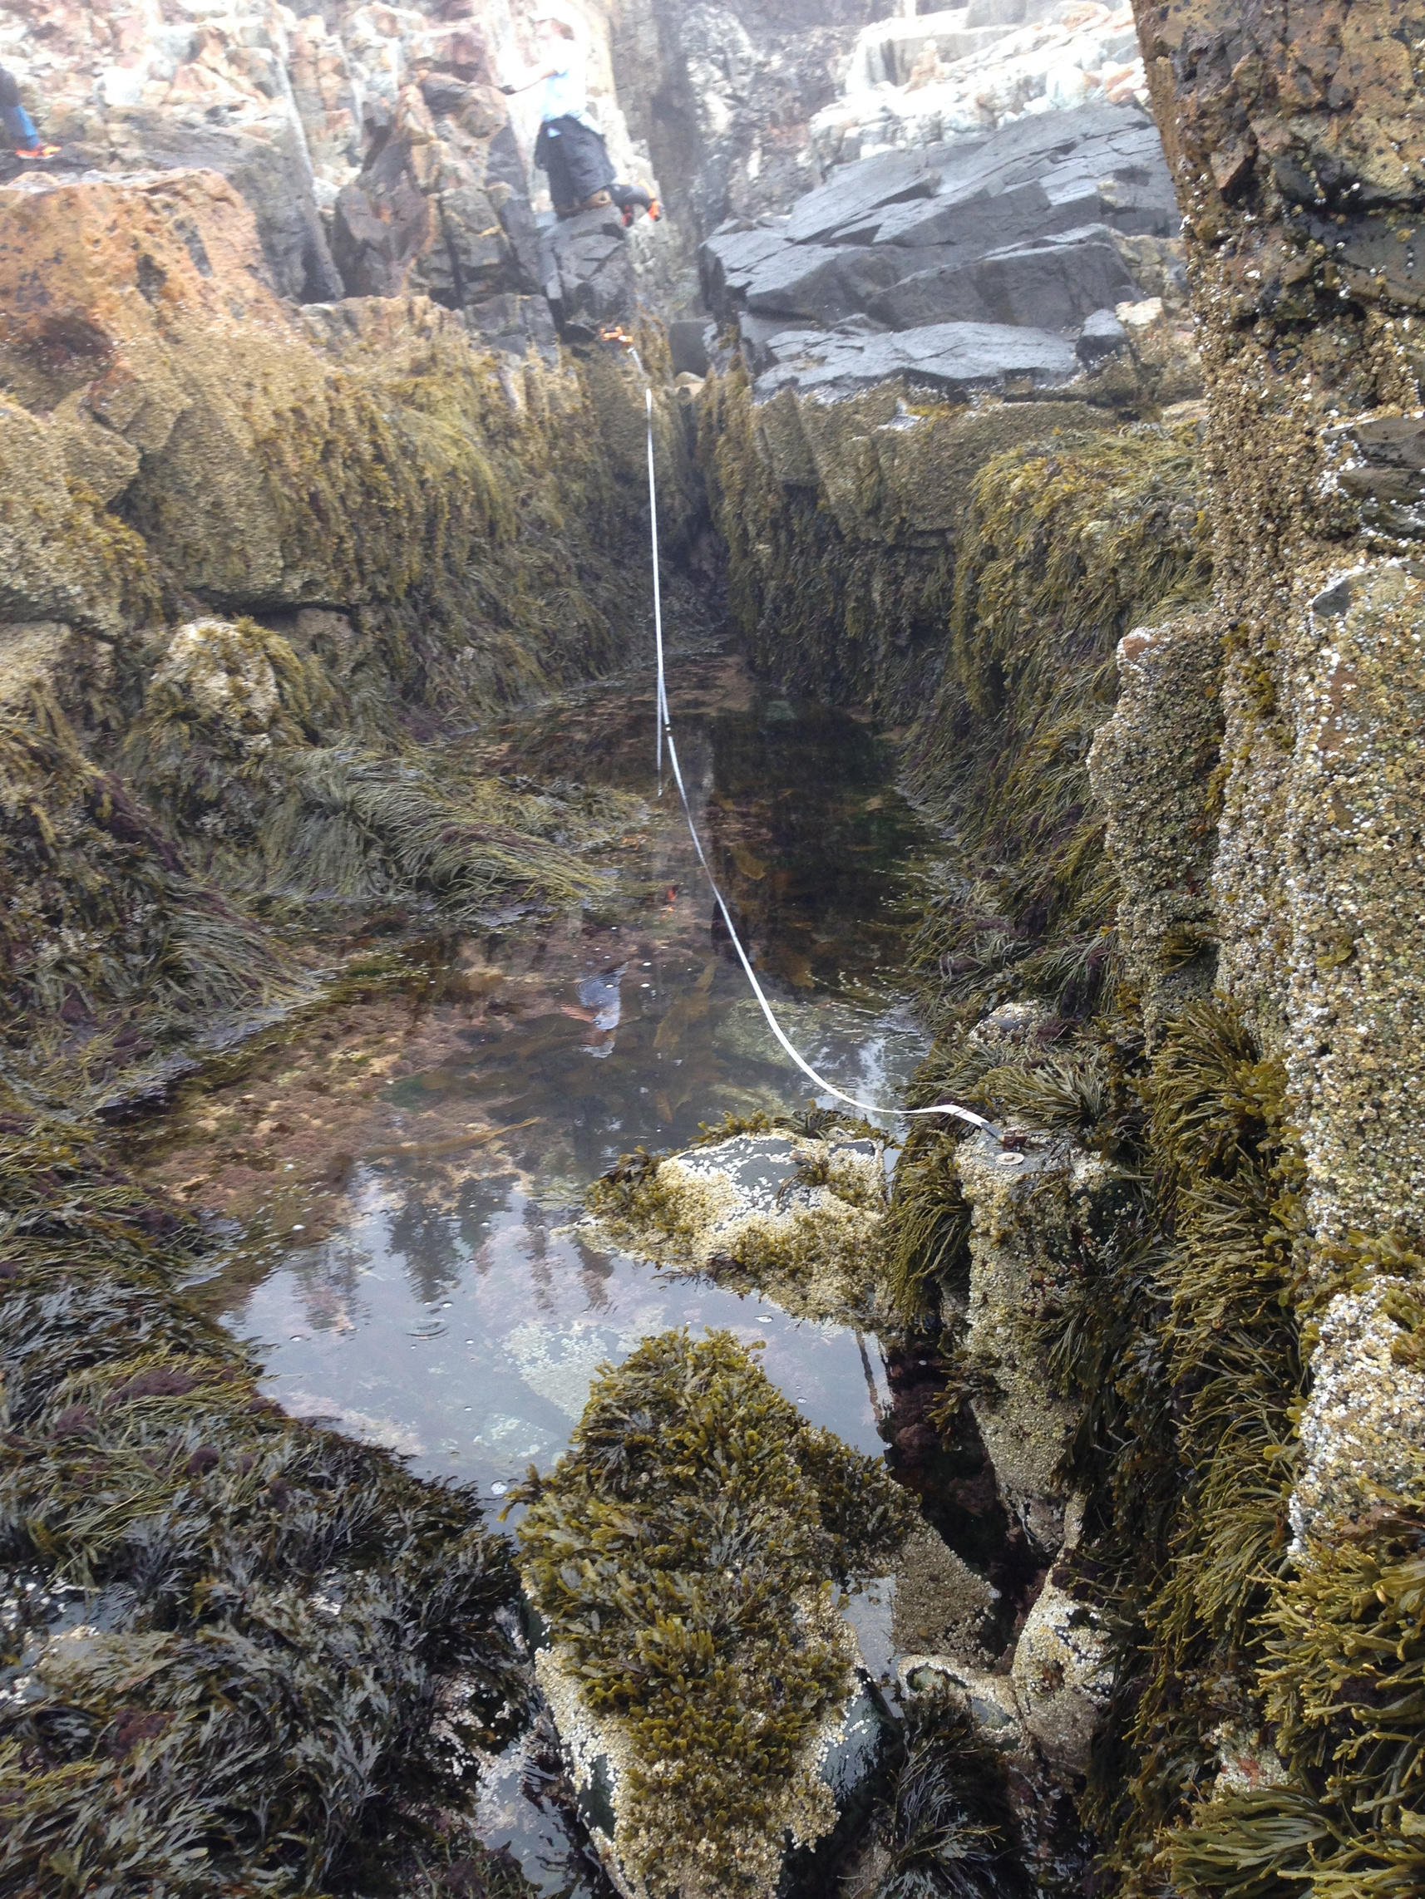
NETN Monitoring Protocol
Invertebrates & Algae
Motile invertebrate species included in model

Slide 9



NETN Monitoring Protocol
Invertebrates & Algae
Motile invertebrate species included in model
Percent cover (0 – 100%) data for algae and other substrate (barnacles, mussels, rock, etc.)

Slide 10
NETN Monitoring Protocol
Invertebrates & Algae
Motile invertebrate species included in model
Percent cover (0 – 100%) data for algae and other substrate (barnacles, mussels, rock, etc.)
Five years of data, ~40 parameters, ~750 observations

Slide 11
Modeling Decision Making
Non-Linear Data
Ecological data is often heavily skewed towards zero
Transformation and EDA yielded no benefits

Slide 12
Modeling Decision Making
Non-Linear Data
Ecological data is often heavily skewed towards zero
Transformation and EDA yielded no benefits
Importance Metrics
Needed for informing park management
Best for interpretability and relating to existing literature

Slide 13
Modeling Decision Making
Adjacency Matrix
Decision Tree Models
Binary matrix describing predator-prey interactions
Randomly generated invasive
Handle the “Curse of Dimensionality” well
Handle non-linearity well
Handle multicollinearity well
Easy to generate importance metrics
“Black box” less detrimental for broad-strokes ecology
Importance Metrics
Needed for informing park management
Best for interpretability and relating to existing literature

Slide 14
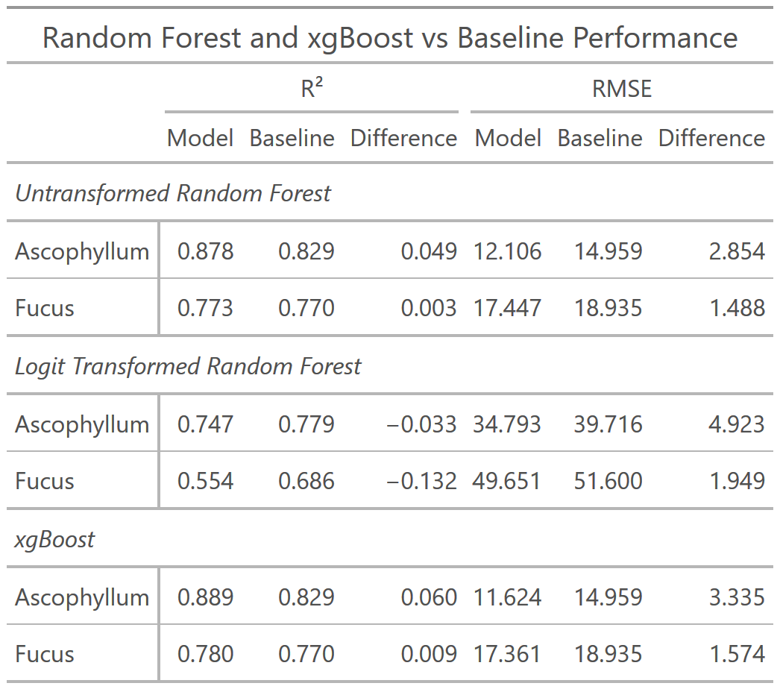

Modeling Results
Moderate performance
XGBoost performed the best out of the three
$R^{2}$value of 0.89 / 0.78
RMSE of 14.96 / 18.94
Moderate improvement over baseline

Slide 15
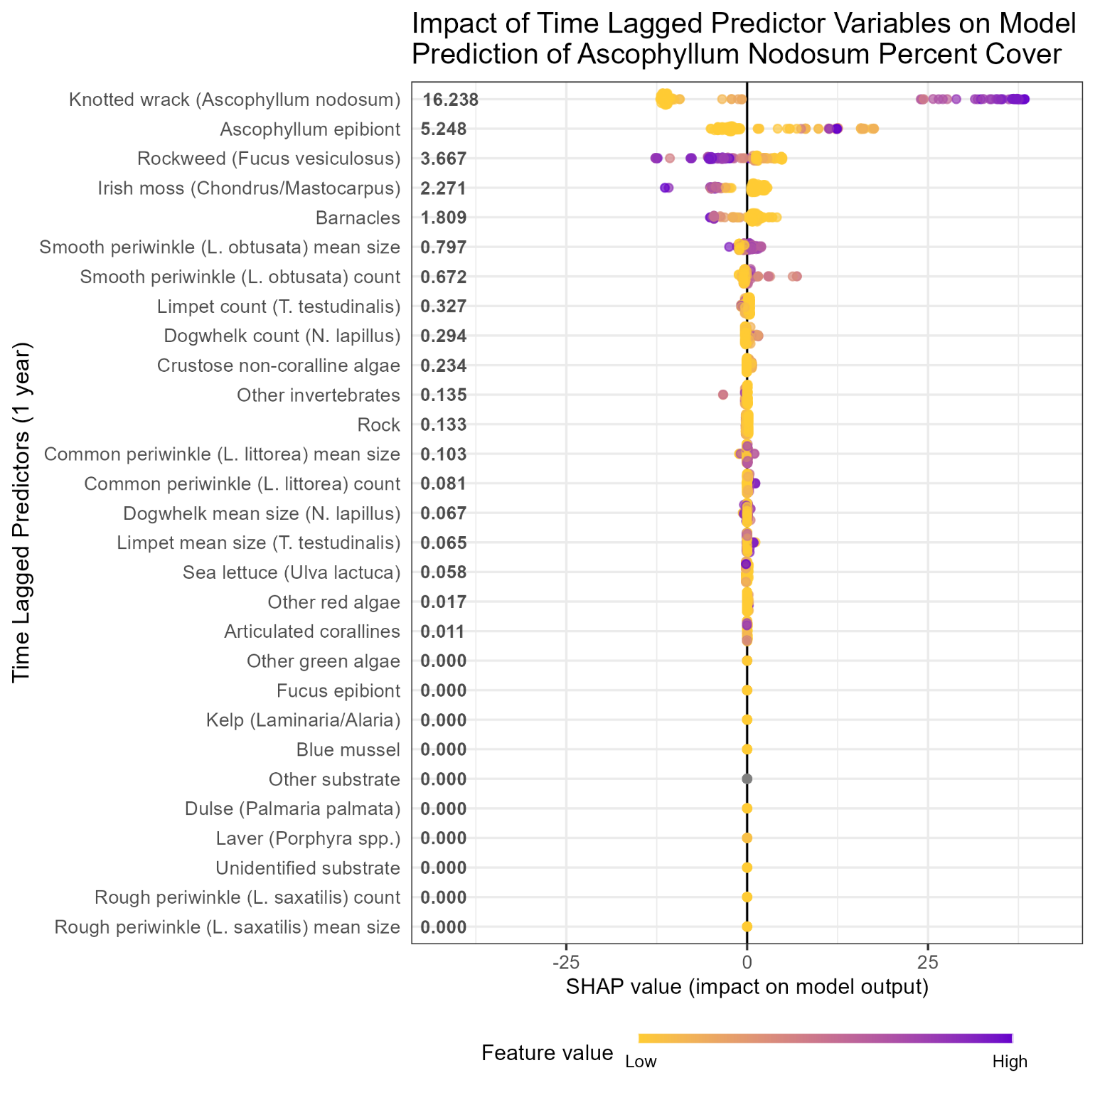
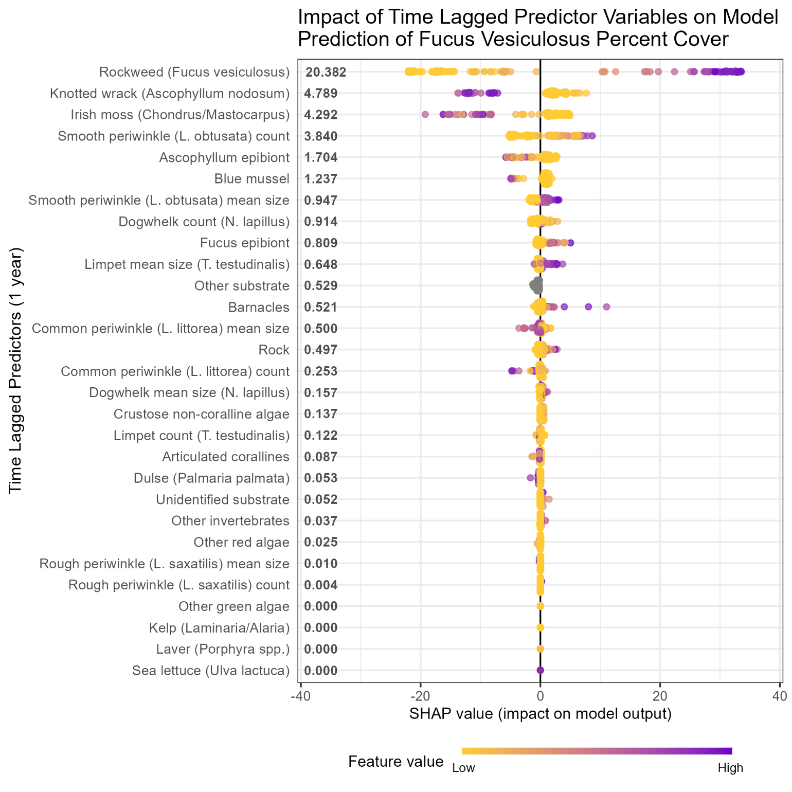
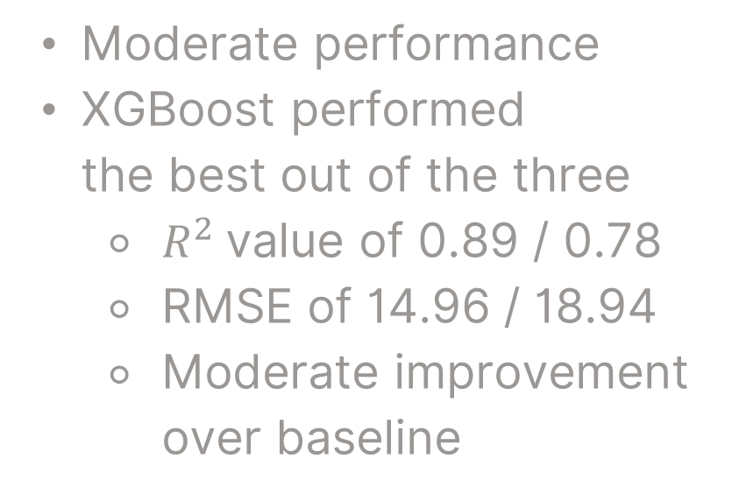
Modeling Results
Moderate performance
XGBoost performed the best out of the three
$R^{2}$value of 0.89 / 0.78
RMSE of 14.96 / 18.94
Moderate improvement over baseline
Previous year’s percent cover most important
Some evidence of competition between algae
Little evidence of invertebrate effect on algae

Slide 16
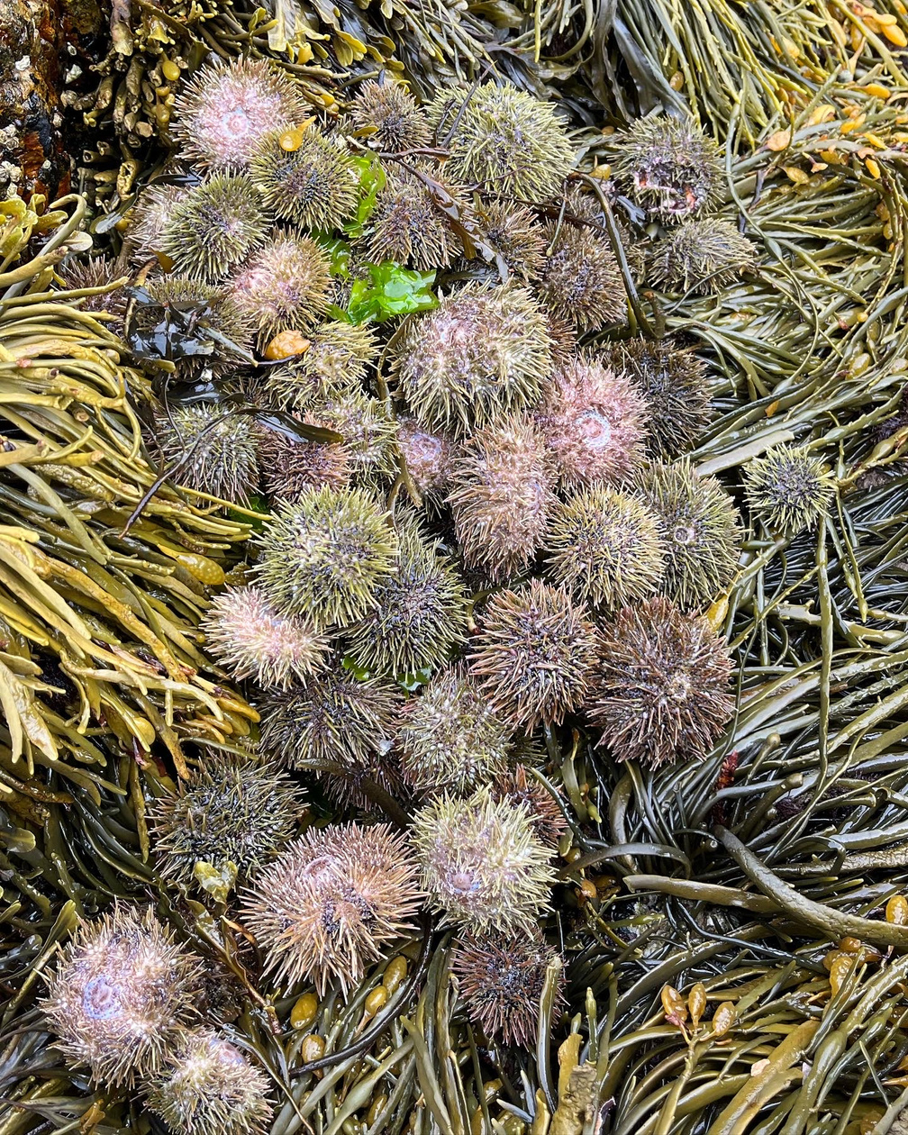
Conclusions
Stable Populations
Previous year’s population is a clear indicator of next year

Slide 17
Conclusions
Stable Populations
Previous year’s population is a clear indicator of next year
Interspecific Interactions
Some evidence of competition, little evidence of grazing
Focus more on trends in algae, environmental factors

Slide 18
Conclusions
Stable Populations
Previous year’s population is a clear indicator of next year
Interspecific Interactions
Some evidence of competition, little evidence of grazing
Focus more on trends in algae, environmental factors
Complex Interactions
Need environmental factors
Deeper and wider data

Slide 19
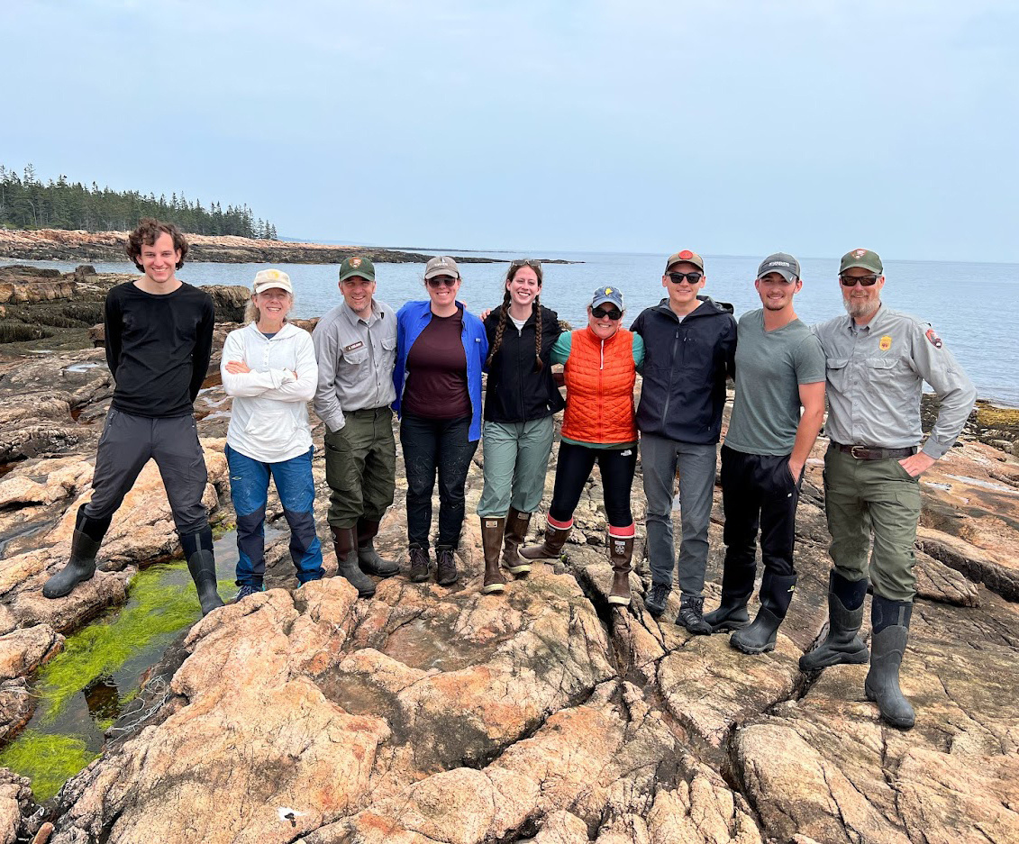
Thank you!
Special thanks to:
Adam Kozlowski, Ed Sharron, Jess Pollack, and the NETN volunteer teams!

Slide 20

Questions?
lagonin@merrimack.edu

